Slide 1

School of Computer Engineering (Software Engineering)
Computer Graphics Mini Project (Review 1)
Roller Coaster Ride Simulation
Students Name:
Yashraj Zagade (65)
Adhyatma Hirap (68)
Sairaj Patil (70)
Parth Patil (75)
Guide:
Mrs. Gauri Thite

Slide 2
Index
Introduction
Abstract(Aim of your project in five to six lines)
Specify Objects involved in project.
Software/Hardware Requirement
Proposed System
Implementations details (description of various functions used in project)
Design
Demonstration
References

Slide 3
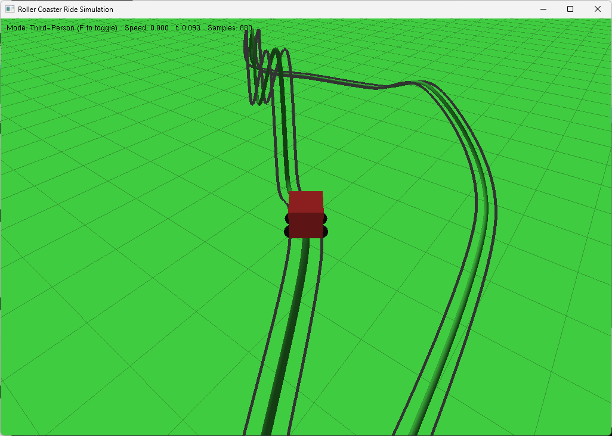
Introduction
This project is a 3D Roller Coaster Simulation developed in OpenGL and GLUT (C++), showcasing computer graphics concepts like spline-based curve modeling, camera transformations, and real-time animation. The track is generated with Catmull-Rom splines for smooth interpolation, while a moving carriage follows the path using tangent and normal vectors. Features include first- and third-person camera views, user-controlled speed, and rendering elements such as lighting, ground grid, and tubular track geometry for realism. Interactive keyboard controls make the simulation engaging, highlighting the blend of mathematics and graphics programming in creating immersive experiences.

Slide 4
Problem statement
Traditional methods of visualizing roller coasters are limited to static diagrams or videos, which do not provide an interactive or immersive experience. There is a need for a computer graphics-based simulation that can realistically model a roller coaster track, demonstrate motion along 3D paths, and allow users to experience the ride from multiple perspectives with real-time controls.
Define Objects
Roller Coaster Track – generated using Catmull-Rom splines, rendered as tubular rails.
Carriage/Coaster – cube-shaped model that moves along the track.
Ground/Environment – flat grid or plane to represent the surface.
Camera Objects – dynamic viewpoints for first-person and third-person perspectives.
Lighting Sources – to enhance realism and depth.
Auxiliary Objects – cross beams/sleepers, side rails, and background elements for detail.

Slide 5
Software Requirement
Operating System: Windows / Linux
Programming Language: C++
Graphics Library: OpenGL, GLUT/FreeGLUT
Compiler/IDE: Code::Blocks / Visual Studio / GCC with OpenGL support
Version Control: Git & GitHub (optional, for collaboration)

Slide 6
Proposed System
The proposed system is a 3D roller coaster simulation that models a track using Catmull-Rom splines and animates a moving carriage along it. The system integrates:
Track Generation Module – creates smooth paths from control points.
Carriage Animation Module – moves the coaster along the spline using tangent and normal vectors.
Camera Module – provides first-person and third-person ride perspectives.
Rendering Module – handles lighting, ground, rails, and real-time display.
User Interaction Module – allows speed control and view switching via keyboard.

Slide 7
Implementation details
glutInit() : Initializes the GLUT library and establishes interaction with the windowing system.
glBegin()/glEnd() : Define primitives (lines, quads, etc.).
glVertex3f() : Specify 3D vertex coordinates.
glColor3f() : Set the current drawing color.
glTranslatef(), glRotatef(), glScalef() : Apply transformations for object positioning and orientation.
glLightfv() / glEnable(GL_LIGHTING) : For lighting effects.
glutInitDisplayMode() : Sets the display mode (e.g., double buffering, RGB color, depth buffering).
glutCreateWindow() : Creates the OpenGL rendering window with a specified title.
glutInitWindowSize() : Defines the width and height of the window in pixels.
glutInitWindowPosition() : Specifies the initial position of the window on the screen.
glutDisplayFunc() : Registers the display callback function responsible for rendering each frame.
glutReshapeFunc() : Handles window resize events and adjusts the viewport/projection accordingly.
glutKeyboardFunc() : Processes normal keyboard input (e.g., speed control, camera view).
glutSpecialFunc() : Handles special keys (arrow keys, function keys, etc.).
glutIdleFunc() : Registers a function that is called when no events are being processed, useful for animation updates.
glutMainLoop() : Enters the main event-processing loop, keeping the program running until the window is closed.

Slide 8
Design
Problem Identification: Need for an interactive 3D roller coaster visualization using computer graphics.
System Analysis: Study of OpenGL/GLUT libraries, spline interpolation, and real-time animation methods.
System Design: Designing modules: Track Generation, Carriage Motion, Camera Control, Rendering, User Interaction. Block diagram representation of module interactions.
Implementation: Coding in C++ with OpenGL/GLUT. Using Catmull-Rom splines for track, vector math for motion, and transformations for rendering.
Testing & Debugging: Checking smoothness of track motion, correctness of camera perspectives, and user input response.
Final Simulation: Integration of modules to create an immersive ride experience. Real-time rendering with lighting, ground, and interactive controls.

Slide 9
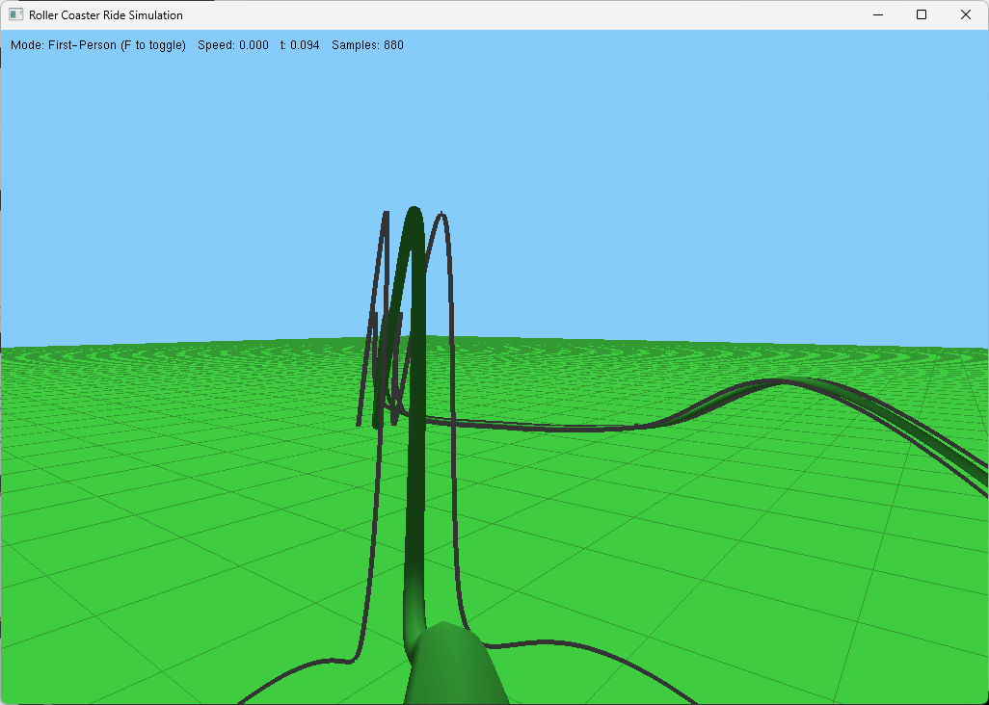
Demonstration
Fig.1 Third person view
Fig.2 First person view

Slide 10
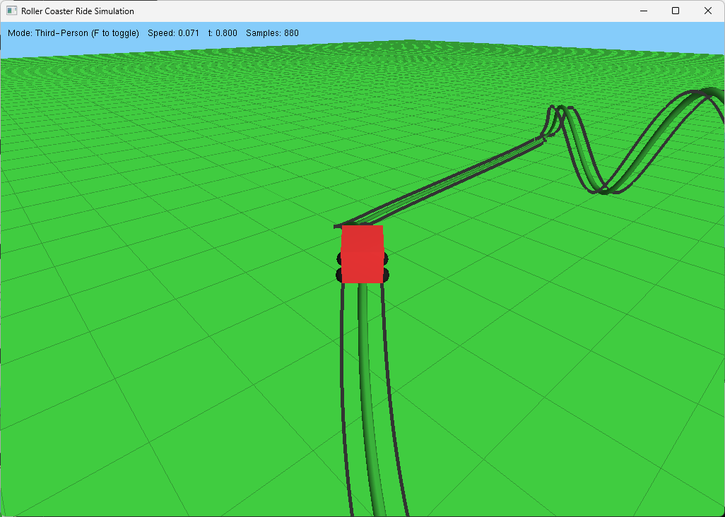
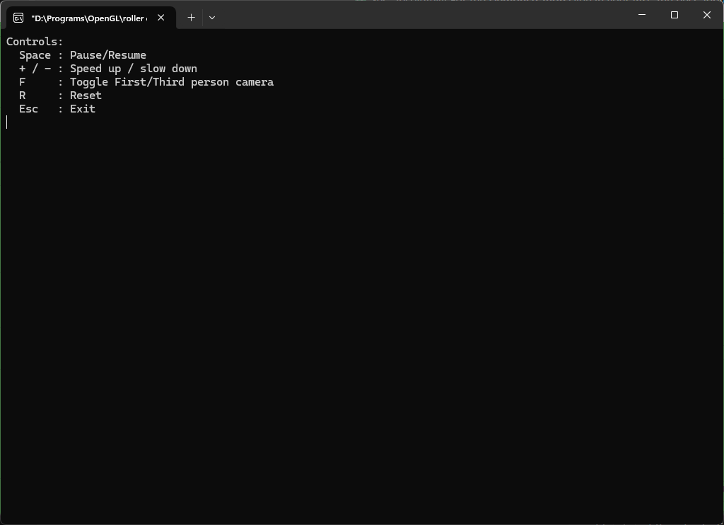
Demonstration
Fig.3 Moving coaster (speed = 0.07)
Fig.4 Terminal

Slide 11
Thank You!!
Any questions.

